Slide 1
Interaction Between the Urban Heat Island and Global Warming
Fiker Zewdie
Supervising Mentor: Dr. Benjamin Cook

Slide 2
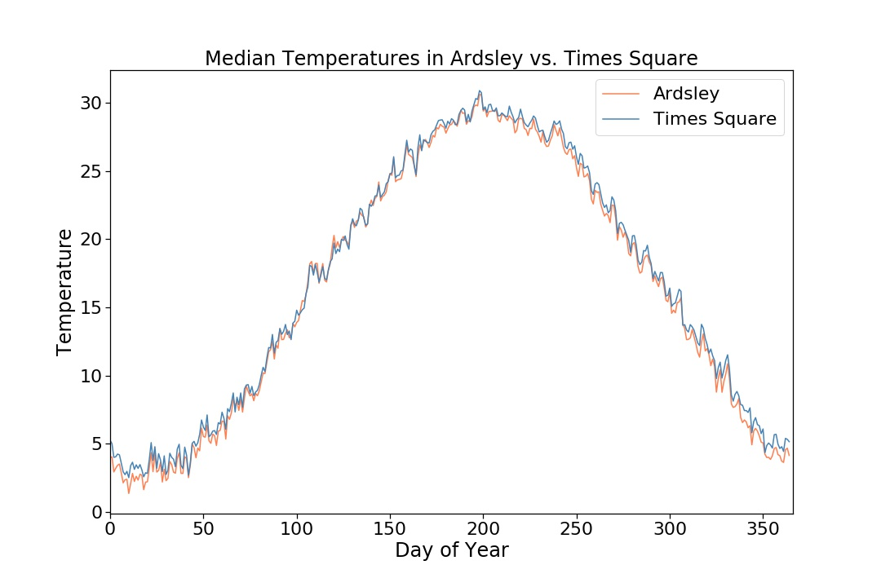
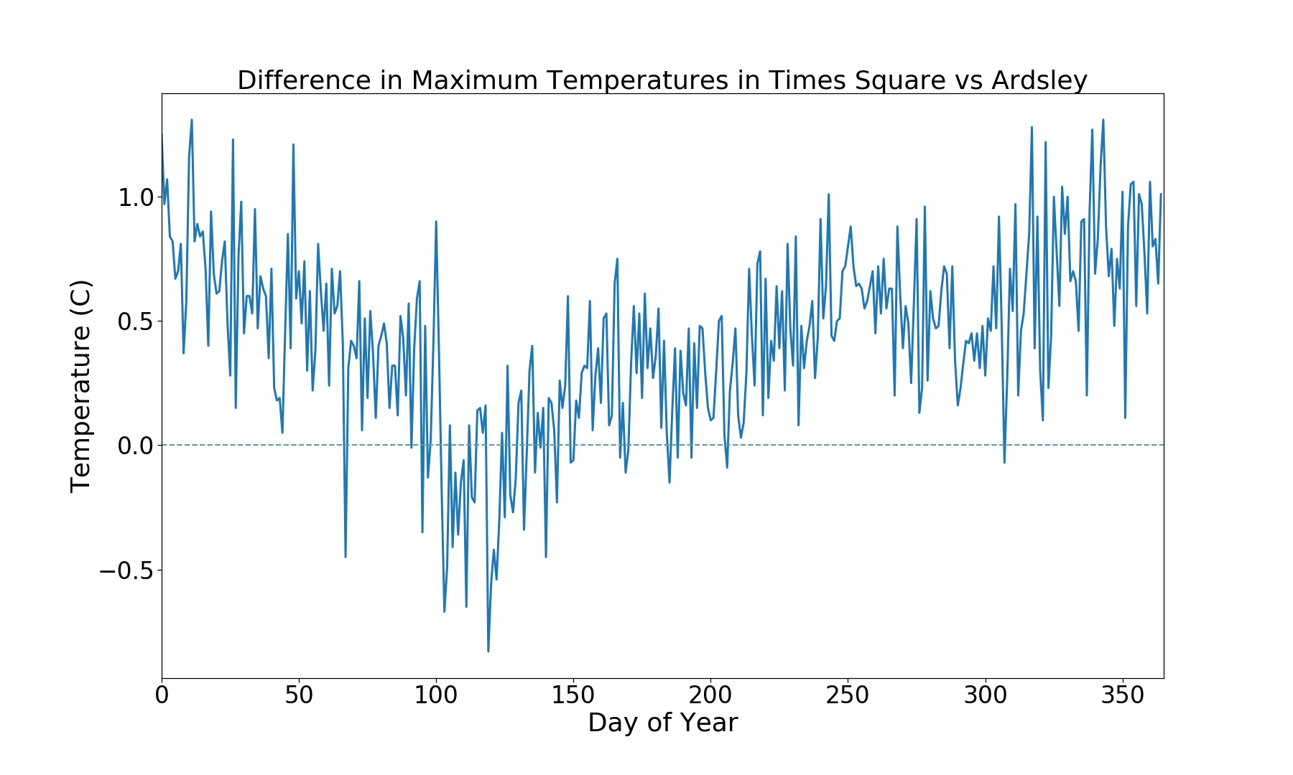
Fig 1A
Fig 1B
Over the course of one year, this graph gives an overview of what a typical year looks like in Times Square and Ardsley. Given that the two locations are in the northeast, they experience coldest temperatures in the winter and the warmest temperatures in the summer.
For a given year, Times Square temperatures fall above temperatures in Ardsley for most of the year. For a given year, this graph shows the difference between Ardsley and Times Square temperatures. When Times Square temperatures fall above temperatures in Ardsley for most of the year, it indicates that Times Square is warmer for a majority of the year.

Slide 3
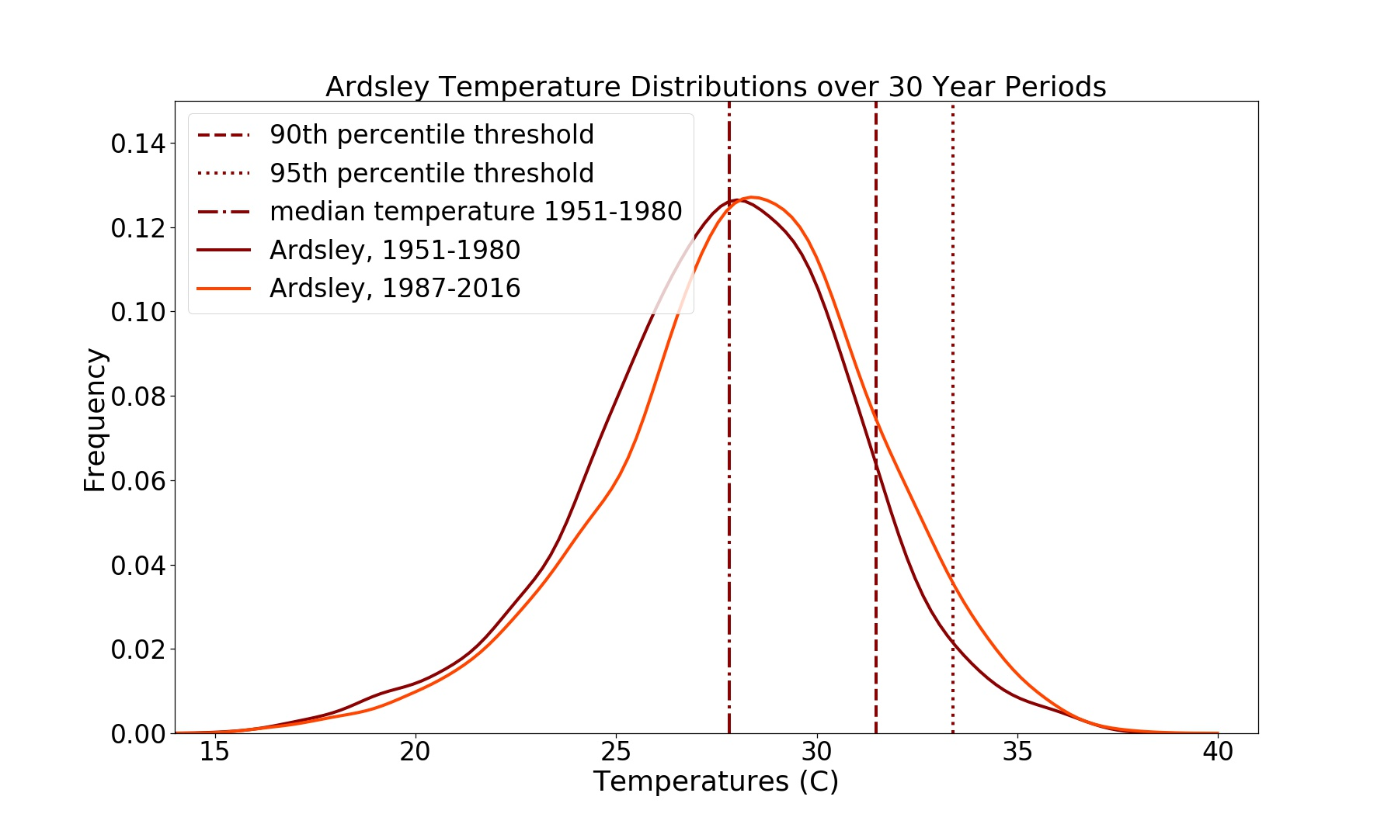
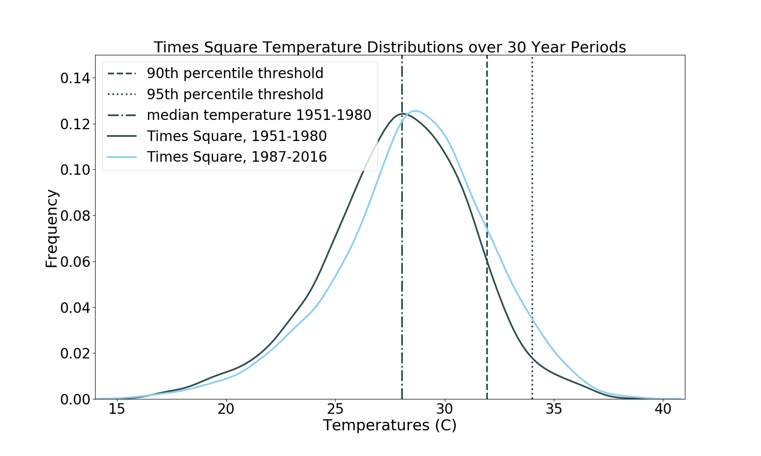
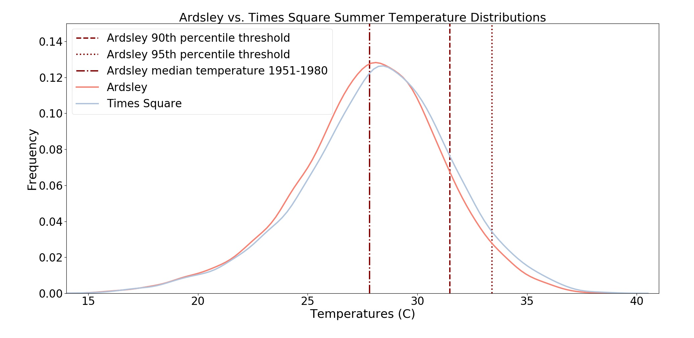
Fig 2A
Fig 2B
Times Square temperatures shifted very slightly in the median, but this seemingly small shift created a large shift in the tails, making the extremes on the warmer end of temperatures more common.
Fig 2C
In Ardsley, the slight shift in the mean temperatures caused a large shift in the extremes. Over the latter time period the number of temperatures that fall above the 90th percentile threshold increased.
In Times Square, the summer median temperature shifted slightly causing a larger number of days to fall above the 90th and 95th percentiles.

Slide 4
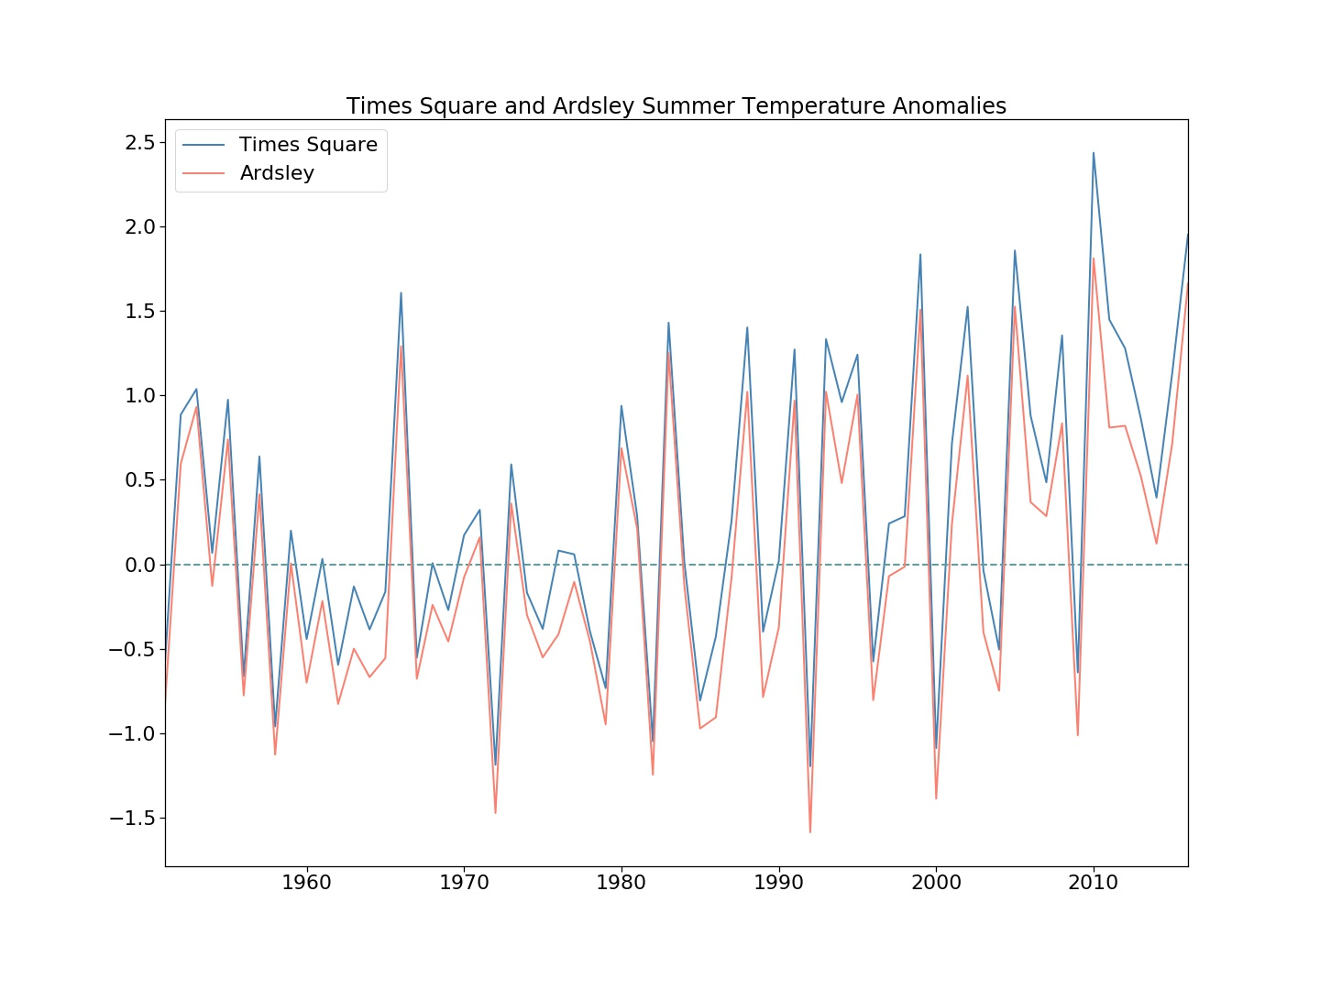
Fig 3B
In both Times Square and Ardsley, mainly because both locations were standardized with respect to their own temperature thresholds. Due to the two locations being in close proximity to each other, the variability trends are similar. In this graph, temperatures in Times Square are generally higher due to the Urban Heat Island effect.

Slide 5
Fig 4
Due to the standardization of both locations to their respective thresholds, the variability of both locations remains very similar. This increase in the number of extreme heat days in both locations is a good indicator that global warming has caused for unusually warmer weather than before.

Slide 6
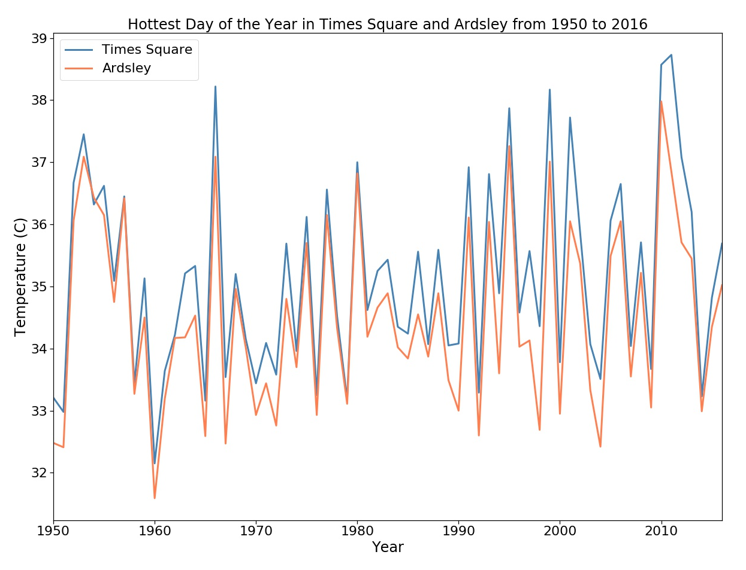
Fig 5
The variability of both Times Square and Ardsley remain similar for the first half of the timeframe. This changes after 1980 and the average temperatures increase at a faster rate in Times Square than in Ardsley.

Slide 7
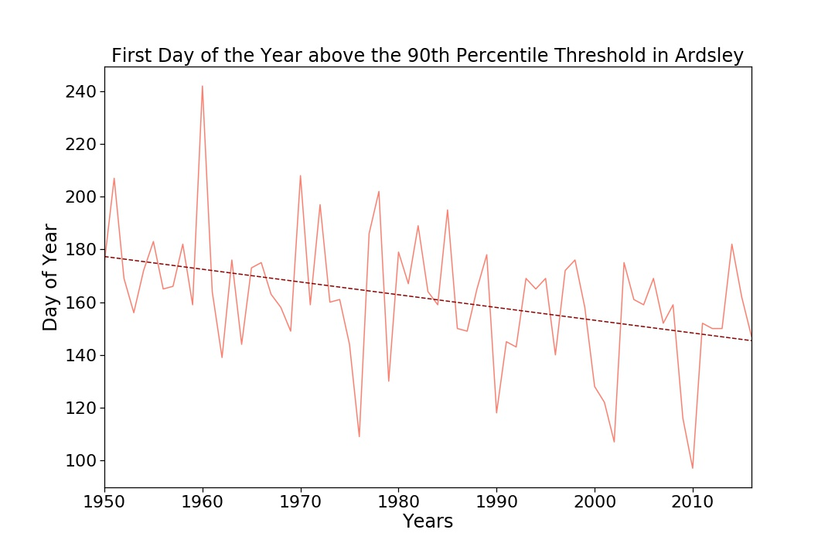
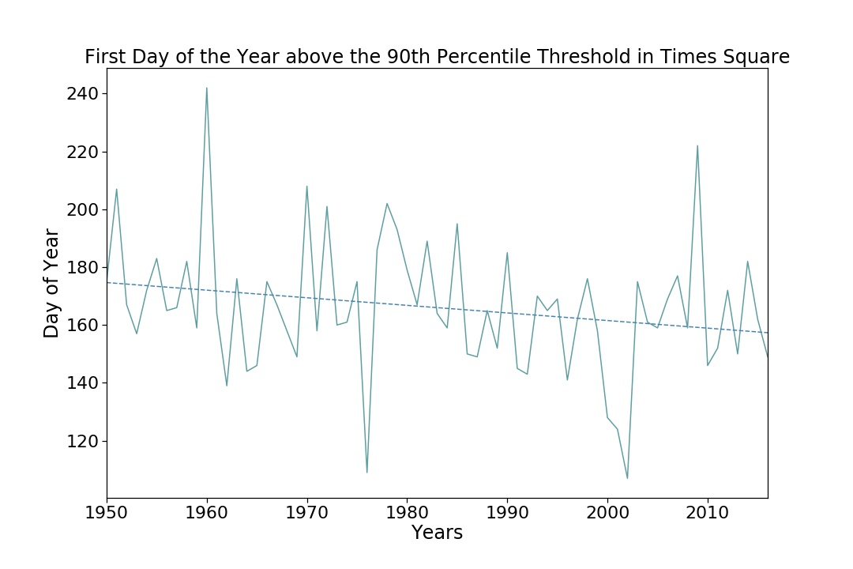
Fig 6A
Fig 6B
In Ardsley, the first day of the year above the 90th percentile threshold (for the years between 1951-1987) falls earlier overtime. A statistically significant linear relationship was drawn using a linear regression model, which estimated that for every year, the first day of the year above the 90th percentile threshold would fall about half a day earlier.
In Times Square as well, the first day of the year above the 90th percentile threshold (for the years between 1951-1987) falls earlier overtime. The linear regression model drew a weaker, but helpful model that predicted that temperatures would fall above the 90th percentile threshold 0.2 days earlier each year.

Slide 8
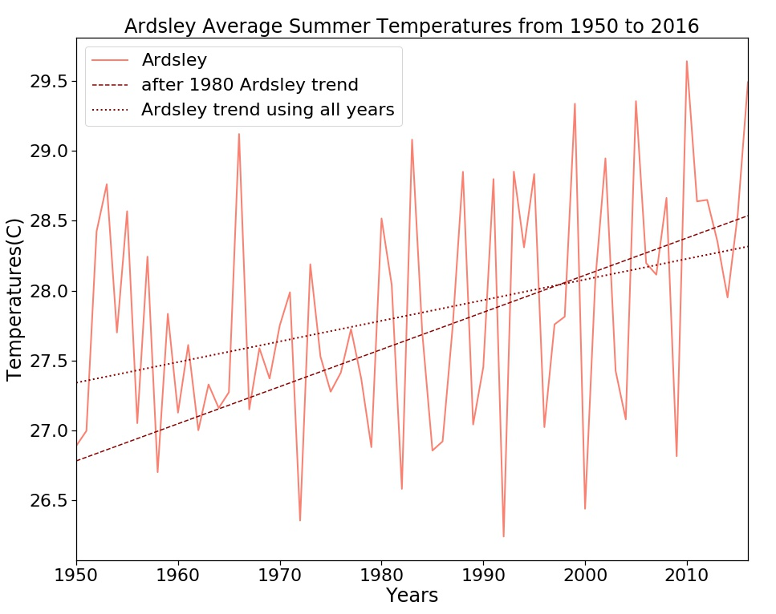
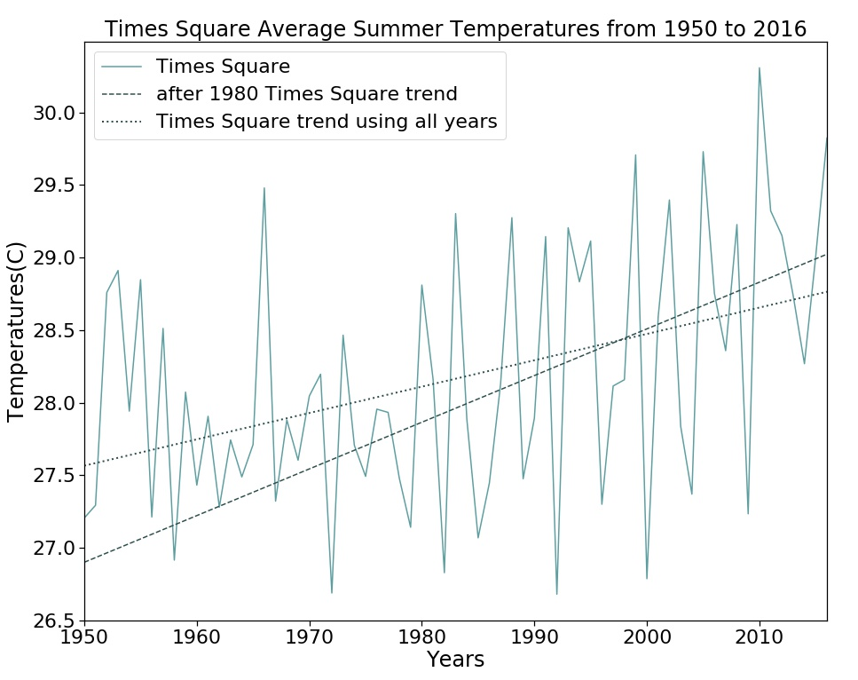
Fig 7A
Fig 7B
The trend using all data from 1950-2016 estimates that by 2050, the temperatures will reach 29.4 degrees Celsius, while the trend considering temperatures from after 1980 estimates 28.8 degrees Celsius.
The trend using all data from 1950-2016 estimates that by 2050, the temperatures will reach 29.4 degrees Celsius, while the trend considering temperatures from after 1980 estimates 30.1 degrees Celsius.
The first trend takes into account the temperatures of all years given, but the second trend takes into account the temperature data after 1980 because there was a drastic increase in the trend after 1980. The second trend may be more reliable if the trend after 1980 were to continue. Though statistically this may be considered a weak trend, this is mainly because of the natural variability from the temperature data over a much smaller time series.

Slide 9
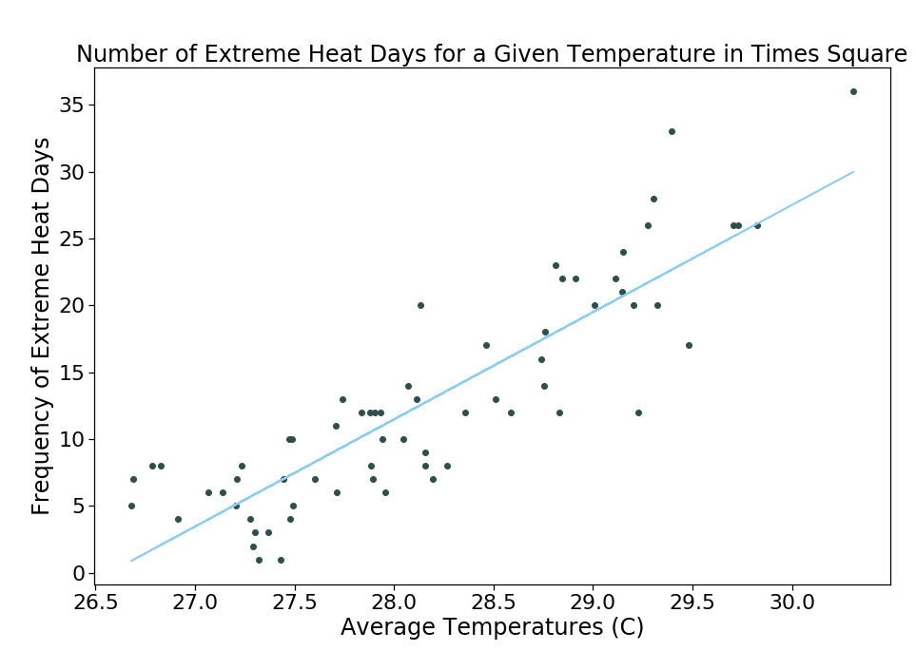
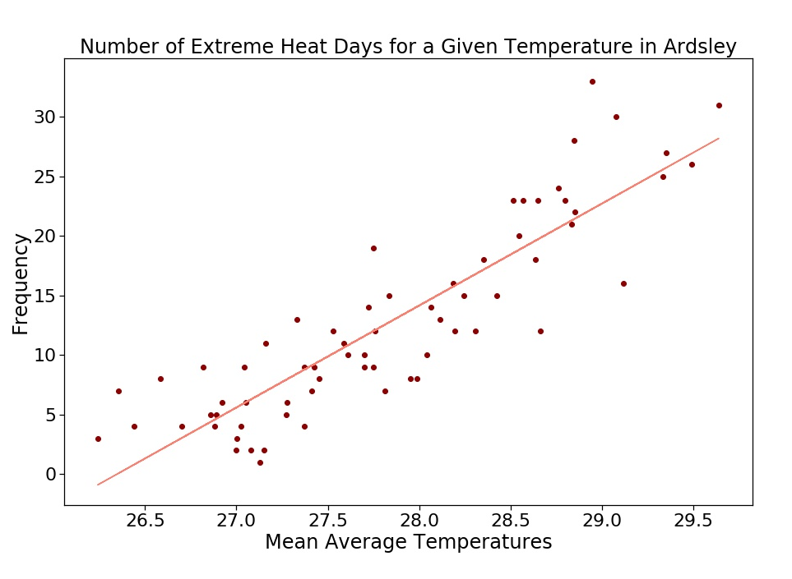
Fig 8A
Fig 8B
In Times Square a relationship could be drawn to estimate the estimated number of extreme heat days for a a given temperature. This statistically significant linear relationship was drawn using a linear regression model that predicted on average about 8 additional extreme heat days a degree increase in temperature.
Similarly, in Ardsley a statistically significant linear relationship was drawn that estimates about 8.6 more extreme heat days for every degree increase.

Slide 10
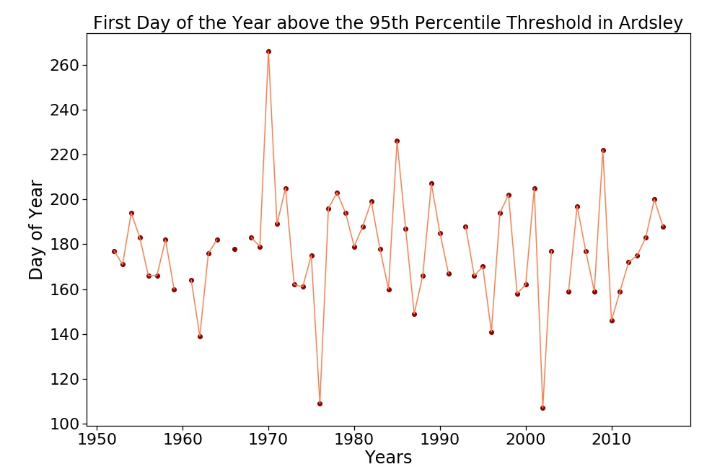
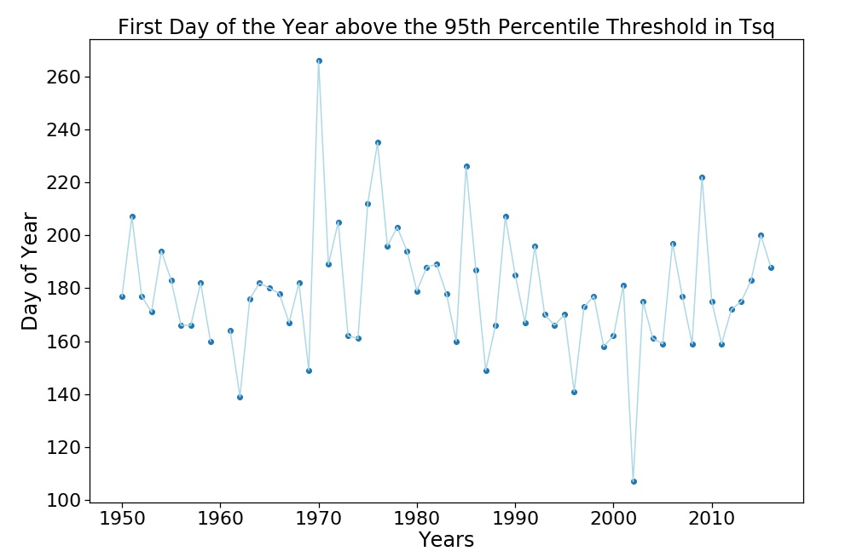
Fig 9A Fig 9B
The trend for the first day of the year above the 95th percentile resulted in no result for some years. The 95th percentile is too high of a threshold to anticipate that one day in the year will fall at or above this threshold. Since this was an extreme threshold, there is very little of a visible trend in this graph.
*These graphs will likely not be included because there was little trend found*

